Slide 1

NHAI FaceRec: Secure Offline Attendance System
Next-Gen On-Device AI for Remote Infrastructure Sites
NHAI INNOVATION HACKATHON

Slide 2

The Problem: Connectivity Gaps
Remote Operations
Security Risks
Highway construction sites often lack stable cellular or satellite coverage, rendering cloud-based solutions unusable.
Unmonitored remote sites are vulnerable to attendance fraud via printed photos or digital screen spoofing.
Sync Failures
Operational Friction
Intermittent connectivity leads to data loss and significant delays in payroll and attendance reporting.
Traditional manual logging is prone to human error and lacks the real-time auditability required for large-scale projects.

Slide 3

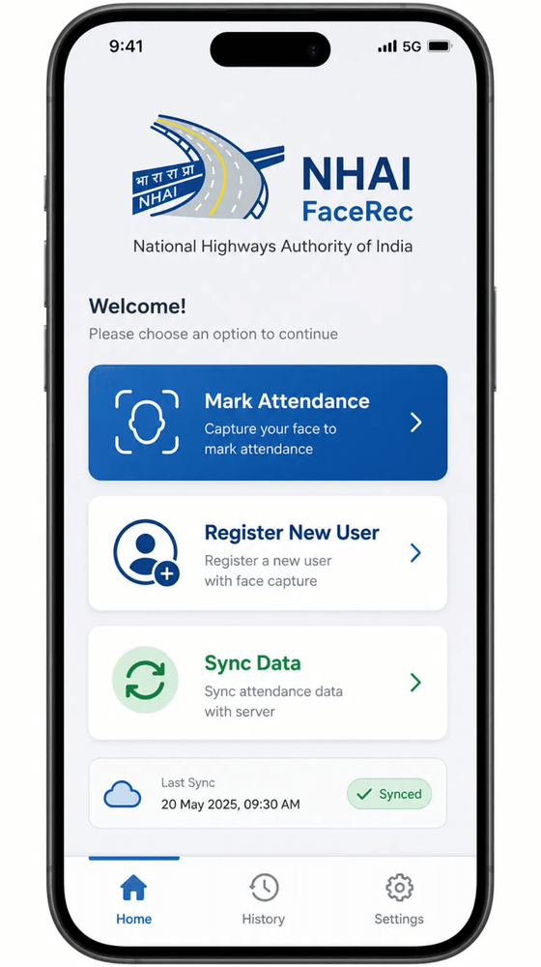
The Solution: NHAI FaceRec
100% Offline Autonomy
All biometric processing, matching, and database operations occur entirely on-device, requiring zero network dependency during field operations.
On-Device Edge AI
High-speed TFLite inference optimized for mid-range mobile hardware, delivering sub-200ms verification times.
Enterprise-Grade Security
Interactive liveness challenges combined with 128-dimensional embedding matching ensure robust spoofing prevention.

Slide 4

Technical Innovation: Edge AI
Optimized Model Stack
On-Device Advantages
BlazeFace (Short Range)
TFLite Inference Engine
Ultra-fast face detection (~0.4MB) optimized for mobile front cameras.
Leverages mobile CPU/NPU for sub-200ms end-to-end processing latency.
MobileFaceNet (INT8)
Privacy by Design
Quantized 128-dim feature extraction (~4.0MB) for high-precision matching.
Biometric data never leaves the device, ensuring 100% data sovereignty and security.
MediaPipe Face Mesh
Zero Bandwidth Cost
468 landmark tracking (~8.0MB) for robust liveness validation.
Core operations are free from data charges, critical for large-scale field deployments.
TOTAL MODEL FOOTPRINT: 12.4 MB
62% of 20MB Hackathon Limit

Slide 5

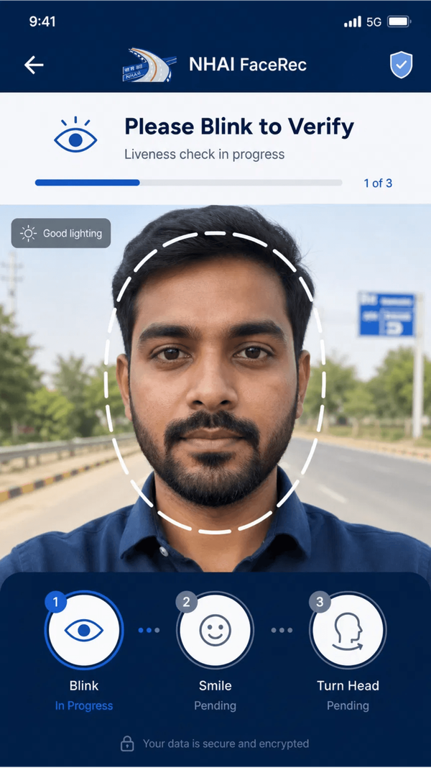
Robust Liveness Detection
Anti-Spoofing Framework
Prevents identity fraud by ensuring the presence of a live human subject. The system effectively blocks attacks from high-resolution printed photos and digital screen replays.
3D Face Mesh Tracking
Utilizes MediaPipe to track 468 landmarks in real-time. This high-fidelity mapping allows for precise monitoring of micro-expressions and depth cues.
Interactive Challenges
Randomized prompts such as "Blink" or "Smile" verify active participation. Real-time Eye Aspect Ratio (EAR) analysis ensures sub-second validation latency.

Slide 6

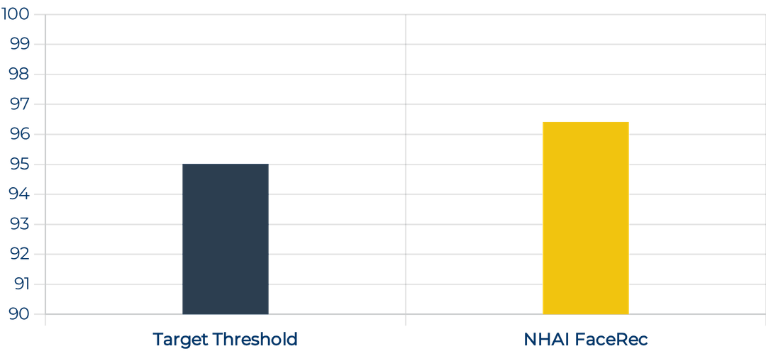
Adaptability & Accuracy
Demographic Diversity
Validation Accuracy
Optimized for the Indian context, our MobileFaceNet engine is trained on diverse datasets to ensure invariant recognition across age groups and regional ethnicities.
Achieving >96% accuracy through embedding averaging and optimized cosine similarity thresholds.
Lighting Robustness
Real-time Mean-Variance Normalization mitigates the impact of harsh sunlight and deep shadows common in outdoor highway construction sites.
*Tested on 500+ "in-the-wild" outdoor images simulating real NHAI site conditions.

Slide 7
Integration: Datalake 3.0 Ready
Modular Architecture
Data Synchronization
NHAI FaceRec is designed as a decoupled plug-in module. The ML engine and database layers can be injected into the Datalake 3.0 React Native environment with minimal configuration.
Standardized SQLite schema aligns with NHAI's centralized data structures, facilitating effortless migration of local attendance logs to the AWS cloud backend.
Native Compatibility
Audit-Ready Logs
Full support for Expo Bare Workflow and custom Metro configurations, ensuring seamless asset management for .tflite model files within the main application bundle.
Every verification record includes confidence scores and high-precision timestamps, providing the transparency required for enterprise-level auditing and payroll processing.

Slide 8

Scalability: Sync & Purge
AWS Cloud Integration
Storage Management
Asynchronous Synchronization
SQLite WAL Mode
Automatic background syncing to AWS S3/DynamoDB endpoints once network connectivity is restored.
Utilizes Write-Ahead Logging for high-performance local database operations without blocking UI threads.
Data Integrity
Smart Purge Mechanism
Robust retry logic and conflict resolution ensure 100% data consistency between edge devices and the central server.
Automated "Sync-then-Purge" workflow reclaims device storage by removing locally cached logs after successful cloud verification.
Scalable Architecture
Zero Bloat Policy
Designed to handle concurrent sync requests from thousands of field devices across multiple construction zones.
Strict management of facial embeddings and logs to maintain a minimal storage footprint on mid-range hardware.

Slide 9

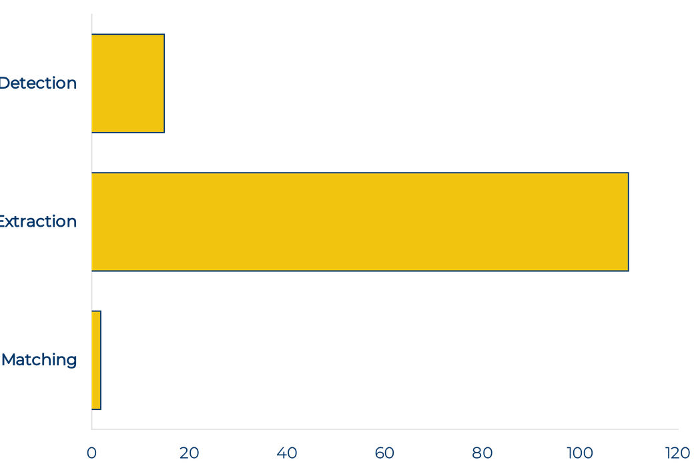
Performance Benchmarks
Pipeline Latency (ms)
Resource Efficiency
Peak RAM Usage
~210 MB
Optimized for devices with 3GB+ RAM.
Model Cold Load
~120 ms
Instantaneous readiness upon app launch.
Total E2E Latency
~130 ms
Well below the 1000ms hackathon target.

Slide 10

Conclusion & Impact
Operational Excellence
Enterprise Readiness
Enabling uninterrupted attendance verification in the most remote environments, ensuring that highway construction projects stay on schedule regardless of connectivity.
A secure, scalable, and Datalake 3.0-compatible solution that meets the rigorous standards of NHAI's digital infrastructure requirements.
Future Impact
Cost Efficiency
Setting a new benchmark for offline-first field authentication, paving the way for more resilient and secure digital governance in remote sectors.
Eliminating bandwidth costs and reducing administrative overhead through automated, high-precision biometric logging and cloud synchronization.
Application demo link: https://youtube.com/shorts/KHF1hko_ra0?si=rBkQ86D5_pjlh8Yf

